Slide 1
AFRICA AND EUROBOND-ING Trends, Challenges and Way Forward
Mr. Trevor Lwere
Economist - Development Reimagined

Slide 2
Private Bilateral
4.45%
Eurobonds
> 8%
Domestic borrowing
5.5%

Slide 3
Key Findings
19 African countries hold a total of 91 Eurobonds, with a combined face value of US$111 billion.
Just five countries (Egypt, Nigeria, South Africa, Ghana, Angola), hold 65.93% of the bonds and represent 71.1% of the face value.
The Eurobond-debt to GDP ratios vary significantly from 0.87% (Ethiopia) to 25% Gabon (25%), Ghana (24%), and Angola (19%) having the highest relative burdens.
Repayments are expected to present the greatest fiscal strain between 2024-2028
Cost of issuing Eurobonds accentuated by an Africa Risk Premium (2.9 percentage points) in their borrowing costs compared to other regions.

Slide 4
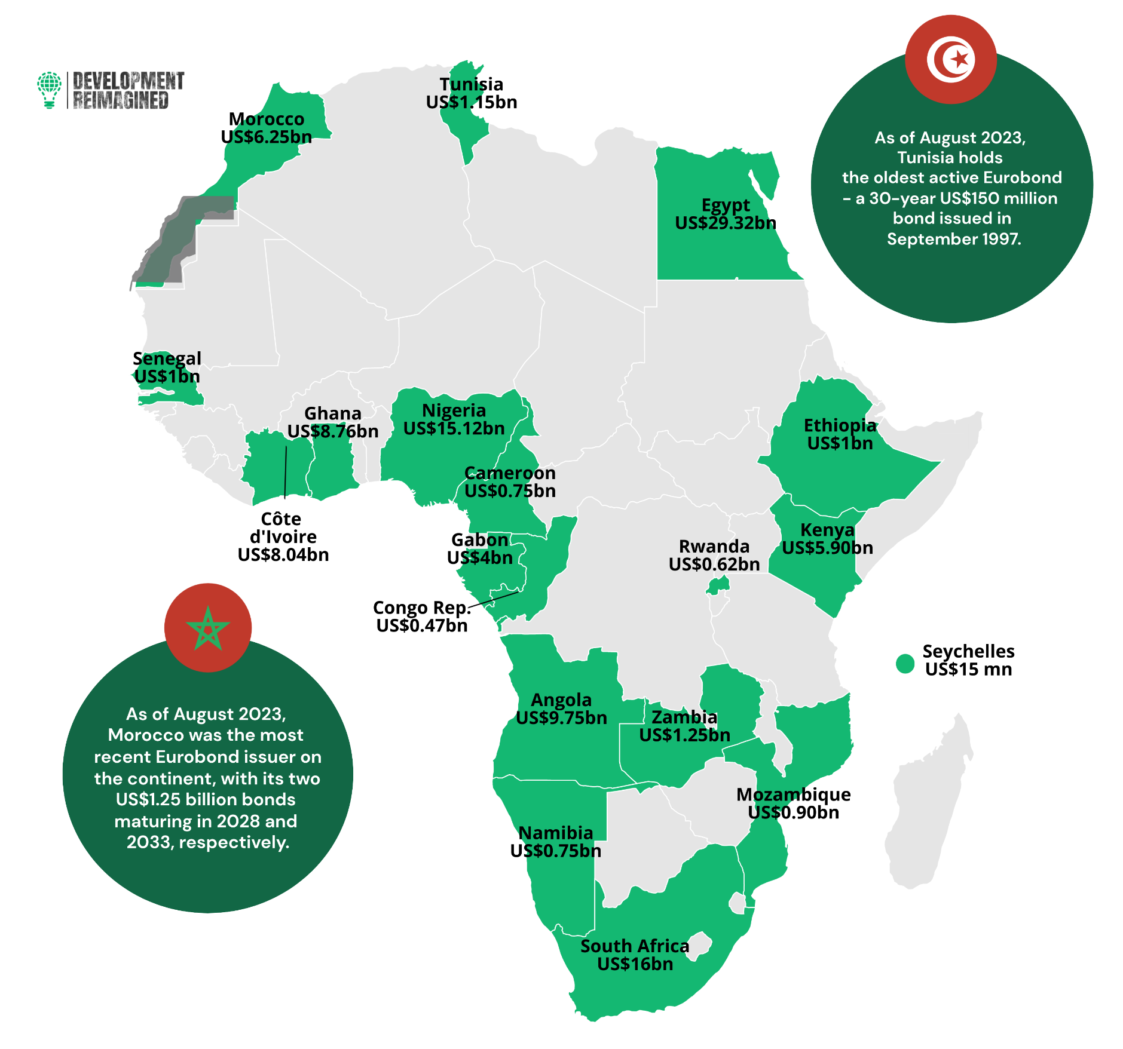
From 1997 - 2023, we analysed 91 outstanding US$-denominated Eurobonds issued by 19 African countries, with a total combined face value of US$111 billion.

Slide 5
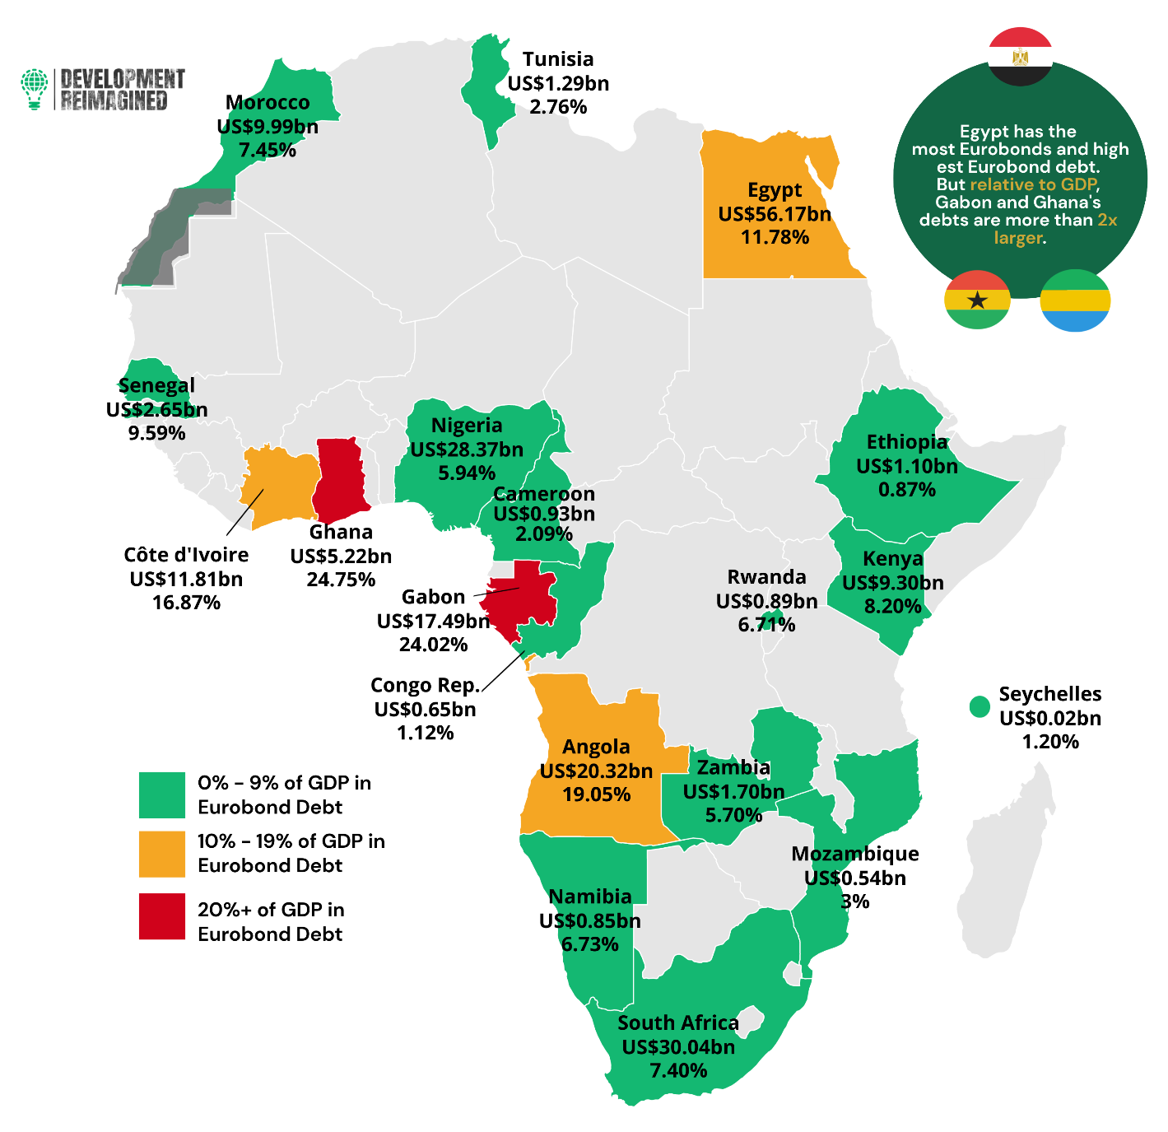
Outstanding Eurobond Debt Stock and Eurobond Debt-to-GDP Ratio (%)
14 countries owe between 0% - 9% of GDP
Three countries owe between 10% - 19% of GDP
Two countries owe over 20% of GDP

Slide 6
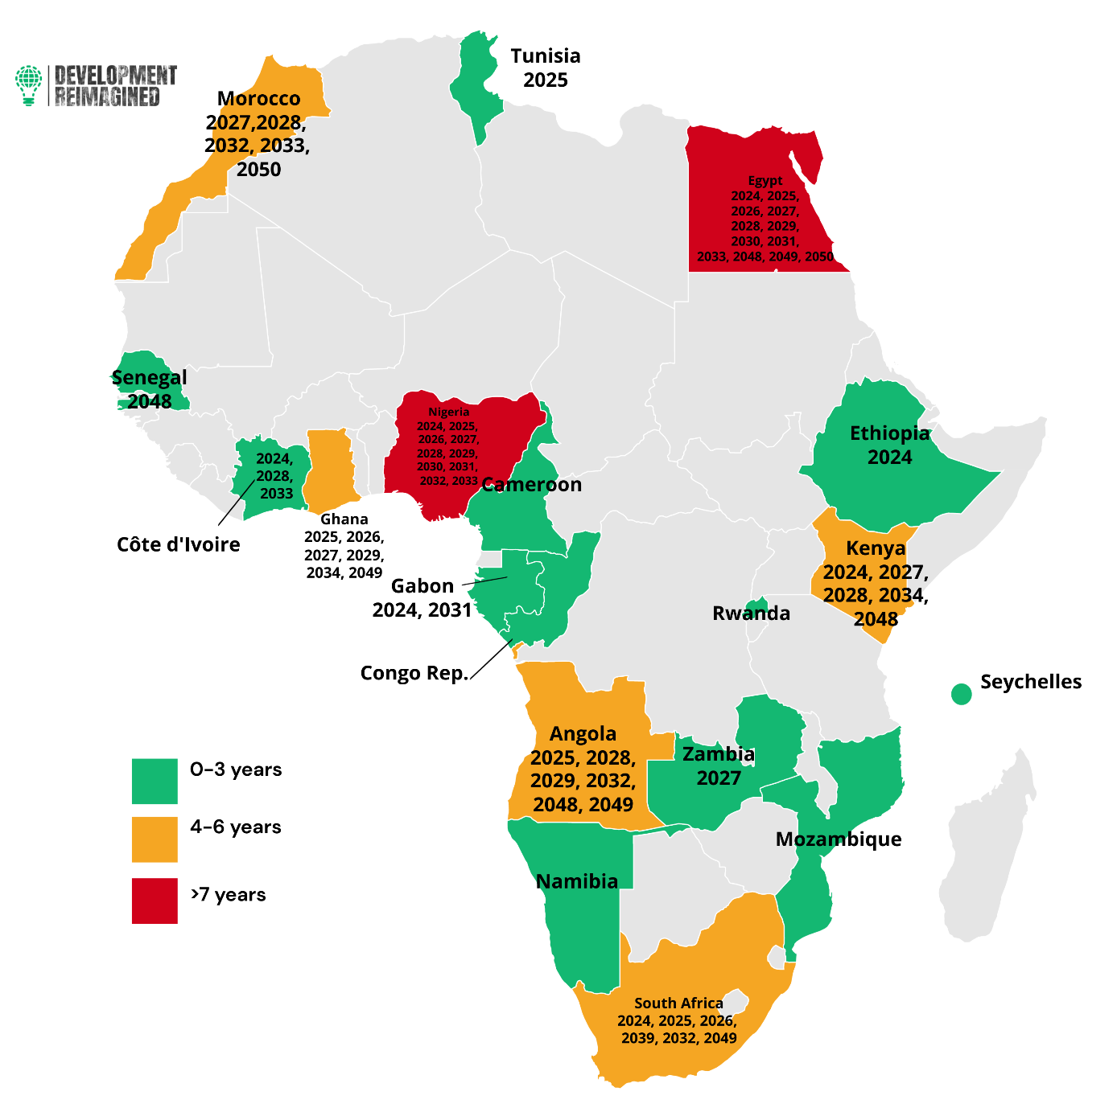
Years of Projected Fiscal Strain from Eurobond Repayments
12 countries have 0-3 years of fiscal strain
Five countries have 4-6 years of fiscal strain
Two countries have 7+ years of fiscal strain

Slide 7
Samurai bonds
1.5%
Eurobonds
> 8%
Panda bonds
3.5%

Slide 8
Recommendations for African Sovereigns
01
Debt Buy-Backs
African countries can consider debt buy-backs or debt repurchases to manage their high-cost debt as this would reduce vulnerability to fiscal shocks and alleviate debt-servicing pressure
02
Alternative Financing Options
Exploring alternative financing sources can help reduce reliance on Eurobonds.
03
Improved Debt Management
African countries can enhance their debt management capacity to better handle Eurobond debt.
04
Longer Maturity Bonds
The report recommends issuing longer-term Eurobonds (as Egypt shifted to in 2010) to reduce the fiscal strain of frequent repayments.
05
Coordination Among African Countries
Coordinated action among African countries can improve their negotiating power with Eurobond holders.

Slide 9
Thank You
clients@developmentreimagined.com

